Slide 1

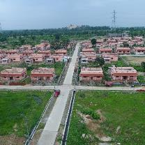


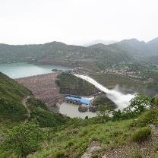


NTPC R&R Colony, Darlipali
NTPC Bhadla
NTPC Kudgi
Draft CERC (Sharing of Inter-State Transmission Charges and Losses) (Fourth Amendment) Regulations, 2024
NTPC Submission
NTPC Koldam
NTPC Kayamkulam
NTPC Rojmal
Follow us on:
/ntpc1
/ntpcltd1
/ntpclimited
/Company/ntpc
/ntpclimited

Slide 2
Waiver of transmission charges for Hydro generating station (Reg 13(2)(e)(b))
It is proposed that waiver of transmission charges for hydro stations, shall be considered if:
(a) PPAs are signed after 1.12.2022 but before 30.06.2025 &
(b) construction work is awarded on or after 1.12.2022 but on or before 30.06.2025.
Submission:
As per MoP order dated 01.12.2022, for waiver of ISTS charges, the construction work is to be awarded on or before 30.06.2025. Further it does not envisage award of work on or after 1.12.2022.
The draft proposes an additional condition that, for the entitlement of waiver, construction work is to be awarded on or after 1.12.2022.
Such additional condition may place certain hydro stations in disadvantageous condition which have awarded their contract before 1.12.2022 but are striving for signing the PPA.
The condition of awarding construction work on or after 1.12.2022 may not be put.

Slide 3
Delay in CoD and disparity in consequent Liability of Transmission charges ….. (1/2)
Draft Regulation proposes that, if transmission licensee of terminal bay achieves COD, but Connectivity grantee is delayed, the Connectivity Grantee shall pay 100% Yearly Transmission Charges for the bay.
Submission:
2nd amendment to Sharing Regulations for dealing with Upstream & Downstream transmission licensees CoD mismatch, provides that in case of delay, a transmission licensee, is required to pay only lower of 50% of YTC of its transmission system or of the system which has achieved CoD.
However, as per the proposed amendment, generator is to pay 100% YTC of bays, if its CoD is delayed.
This is creating a difference in treatment of delays between generator and Transmission licensee vis a vis delay between two Transmission licensees i.e.
if there is a delay of CoD of generator, it has to pay 100% of the YTC, while if there is a mismatch of CoD among transmission licensees, the delayed licensee pays only 50% of the YTC.
As generator may get delayed due to various reasons which are beyond its control, parity in treatment of delay may be provided by following:
In case of delay on the part of generator in achieving CoD, it shall require to pay 50% of YTC of transmission system which has achieved CoD.

Slide 4
Delay due to force majeure and Waiver of Transmission charges …….. (1/4)
The proposed Amendment 13 (2) (h) provides that If:
Any REGS based on wind or solar source has its scheduled date of commissioning on or before 30th June 2025 &
Its CoD gets delayed on account of any Force Majeure event including non-availability of transmission or for reasons not attributable to the REGS & It is granted extension of time to achieve COD by the competent authority (REIA , or a distribution licensee or an authorized agency on behalf of distribution licensee, or the Commission)
The project achieves COD before the extended date, It shall be eligible for a waiver of inter-state transmission charges as if the said REGS had achieved COD on 30.6.2025 and such extension shall not exceed a period of six months at a time and not more than two times.
Submissions:
Duration of extension:
Since the Force majeure conditions are beyond the reasonable control of REGS &
Extension is being provided by REIA considering all facts and reasons,
The limitation of duration & number of extensions may not be stipulated.

Slide 5
Delay due to force majeure and Waiver of Transmission charges ……..(2/4)
Waiver of transmission charges on account Force majeure conditions after 30.06.2025:
Relief due to Force majeure is applicable only if the scheduled date of commissioning is on or before 30th June 2025.
However, the REGS/RHGS having scheduled date of commissioning after 30th June 2025 may also be subjected to the similar force majeure conditions.
Hence the similar provisions may also be provided for such REGS/RHGS.
Regulation 13(2)(h) may also be made applicable to REGS or RHGS based on wind or solar source whose scheduled date of commissioning is after 01.07.2025 to 30.06.2028

Slide 6
Delay due to force majeure and Waiver of Transmission charges ……… (3/4)
Start date of connectivity:
  Amendment is proposing to extend the waiver of transmission charges by granting an extension in CoD.
  However, as CoD has got delayed due to certain reasons like force majeure, the RE generator shall continue to be liable for payment of transmission charges before achieving the CoD.
  In order to exempt RE generators from transmission charges liability, the start date of connectivity may also be extended accordingly.
  Hence a proviso may be provided as follows:
The period of start date of connectivity shall also get extended according to the extension in CoD.

Slide 7
Delay due to force majeure and Waiver of Transmission charges ……… (4/4)
Granting of Extension in case of Bilateral PPA :
  The amendment considers only “a Renewable Energy Implementing Agency or a distribution licensee or an authorized agency on behalf of distribution licensee” as competent authority to grant extension of time to achieve COD.
  After implementation of green energy open access, significant Round the clock (RTC) capacities are being planned under captive or third-party mode through open access, wherein bilateral PPA will be signed based on the tariff mutually agreed between the parties.
  The relief in case of delay due to force majeure may be provided to such REGS and RHGS also, wherein the extension of the SCOD will be provided by buyer of the power instead of REIA or distribution licensee.
MNRE or any party purchasing power through bilateral PPA as the case may be, may also be considered as competent authority to grant extension of time to achieve COD in case of force majeure.

Slide 8
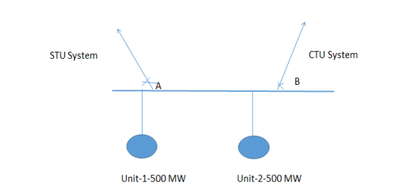
Transmission deviation calculations for Generating Station with dual connectivity.. (1/2)
The Draft Amendment proposes to insert Reg 12(1)(a) as below:
“Generating Station having dual connectivity to both inter-State transmission system and intra-State transmission system, the transmission deviation shall be computed as net metered ex-bus injection, in a time block in excess of (GNA to the inter-State transmission system + Connectivity with STU system)”
Submission:
Though the Generator is dual connected and is injecting in both the systems, however its total deviation is being treated as per Central Commission Regulations.
It is submitted that the deviation may be apportioned as per the connectivity quantum to CTU and STU systems.
Illustration: A generating station with 2 units of 500 MW each.
a. Access with ISTS: 500 MW
b. Access with STU System: 500 MW
If for a particular time block injection at point B is 600 MW and at point A
is 500 MW.
Transmission Deviation for the said block = {1100 – (500+500)} MW = 100 MW.

Slide 9
Transmission deviation calculations for Generating Station with dual connectivity.. (2/2)
Transmission deviation may be apportioned and may be treated as below:
50×(500/1000) = 50 MW may be treated as per CERC Sharing Regulations and
50×(500/1000) = 50 MW may be treated as per applicable State Regulations.
In view of above following may be provided:
The charges for deviation apportioned corresponding to GNA to ISTS may be calculated as per the CERC (Sharing of Inter-State Transmission Charges and Losses) Regulations, 2020 and amendments thereof.

Slide 10
Thanks

